Slide 2
DMU
Hacking Society
Steganography

Slide 3


D0nt d0 1ll3gal sh1t
please..

Slide 4

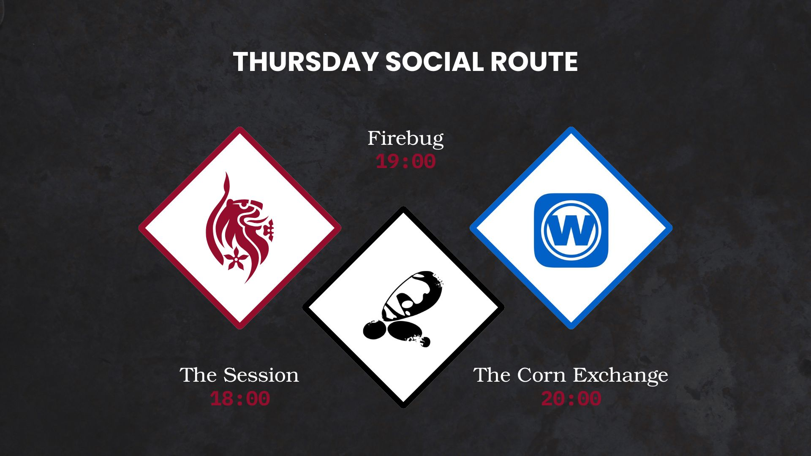

Slide 5
Announcements
DMU Hackers Committee applications open!
5 minute talks
Q-Zips (SOON)
PwnEd Qualifiers (SOON)
P2P Registration Open

Slide 6
What is Steganography?
Steg is a technique of hiding information inside of something else
So, hiding message or files within, usually, something ordinary
The word originates from the Greek
Steganos: meaning concealed or covered
Graphein: to write
Spartan warriors would write messages on wood tablets and cover them in wax. Recipient would the scrape off the wax to read the message

Slide 7
Steganography vs Cryptography?
Cryptography encrypts data - makes it unreadable
Hides the content of a message
Structure of data is changed
Steg hides the data altogether - looks non-suspicious
Hides the existence of a message
Structure stays the same

Slide 8
Why understanding steg is important?
Covert communication
Hides the existence of data - difficult to detect without already knowing there is something to find
Attackers can hide source code for malware - hide it in something that is seemingly harmless, text/image file, for the user to click and “trigger”

Slide 9
Types of Steganography?
Text
Image
Video
Audio
Backmasking
Spectrogram
Metadata
Network

Slide 10
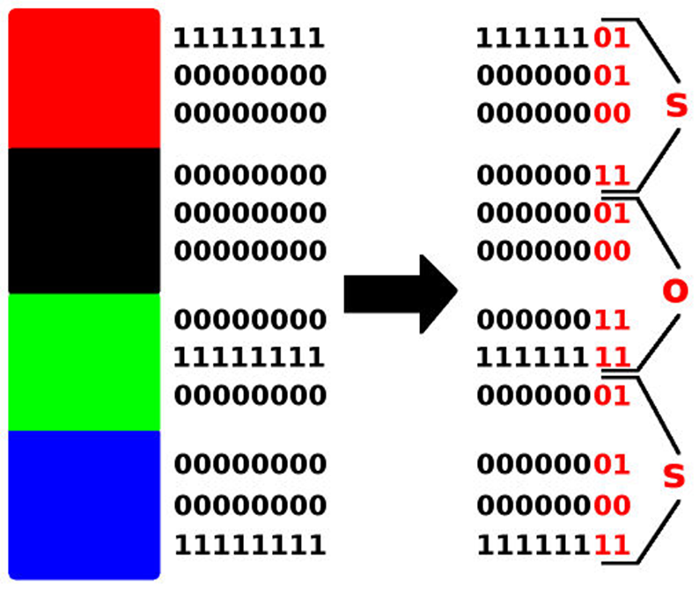
LSB Substitution
The chosen cover image is made up of pixels
Each pixel is defined with RGB
Pixel values range from 0-255, 0 being black and 255 being white
If we change the last bit value of a pixel, not much visual different, changes shade only slightly
Values that make up the data we want to hide is stored in the LSB
To read, you just read the LSB

Slide 11

Text
Includes hiding data into whitespace
Adding or changing spaces, tabs and line breaks
Looks normal, not visible, patterns of the white space encodes binary data - when decoded reveals secret messages
A tool for this is “stegsnow”
Another tool for this type of steg is “stegcloak”
Compresses and encrypts the message before cloaking it with Unicode invisible characters

Slide 12
Image
LSB is the main one
Transform domain methods - DCT
Convert images into frequency blocks
Modify mid-frequency coefficients
Tools like outguess and JSteg

Slide 13
Video
Hiding info in video files
Also can be done with LSB substitution
Or using techniques like DCT and DWT
https://pranavrathod.com/projects/imagecompression/

Slide 14
Audio - Backmasking
Recording messages backwards
Hidden messages that are only deciphered when played in reverse
Used in songs
Missy Elliot - “Work It”:
not technically steganography but still
Simpsons episodes:
propaganda episode

Slide 15
Audio - Spectrogram
Spectrogram encoding
Using tools like audacity or sonic visualiser
Click the track name, select the spectrogram view
You can adjust the scale and colours to see it better
You’d be looking for text, images or QR codes
LSB can also be used on audio
If nothing appears in the spectrogram try checking it with stegolsb

Slide 16
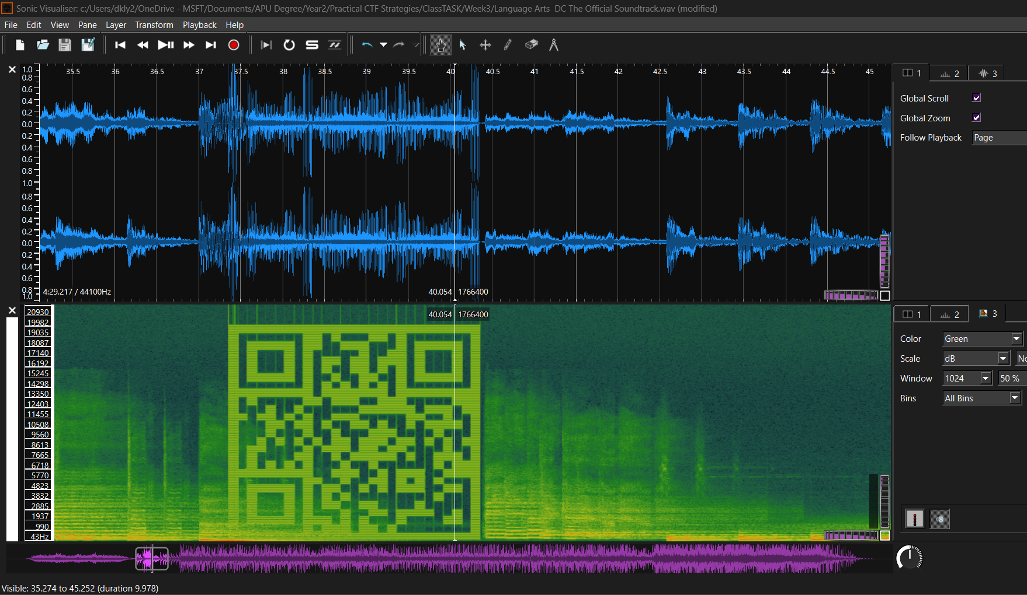

Slide 17
Metadata
Embedding messages into the metadata: images, audio, video
Metadata is often overlooked
Metastego allows you to embed messages into files
It also extracts metadata
Integrity of the file is intact: quality stays the same

Slide 18
Network
Hiding data in network protocols: avoids detection during transmission
Payload based:
LSB
Spread Spectrum Modulation: data dispersed over a wide frequency
Protocol based:
IP header: change IP header fields (like TTL) or identification fields
TCP header: change TCP header fields, sequence numbers and flags

Slide 19
Network
Timing based:
Jitter modulation: Related to the difference in packet arrival timings - changes result in concealed channels
Traffic based:
Manipulate the pattern of traffic: Alter frequency and timing of data transmissions
Introduction to Network Steganography | by Darshan Nere | Medium

Slide 20
Real life example: APT-37
Red Eyes Hacking group (APT 37)
Used a jpg image in a spear phishing email
When the victim clicked the image an exploit was triggered
Ran shellcode on the computer to download and execute a malicious payload stored in the image

Slide 21
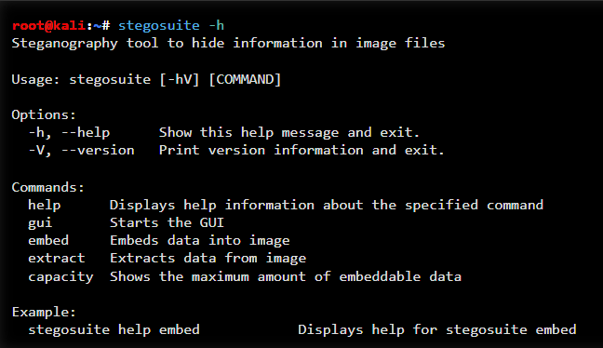
Stegosuite
“Stegosuite is a graphical steganography tool to easily hide information in image files. It allows the embedding of text messages and multiple files of any type. In addition, the embedded data is encrypted using AES. Currently supported file types are BMP, GIF, JPG and PNG. Stegosuite is written in Java and utilizes the SWT toolkit for its interface”
GUI Based application
A bit easier to use if you are not used to the CLI
stegosuite -h to see the tool usage

Slide 22
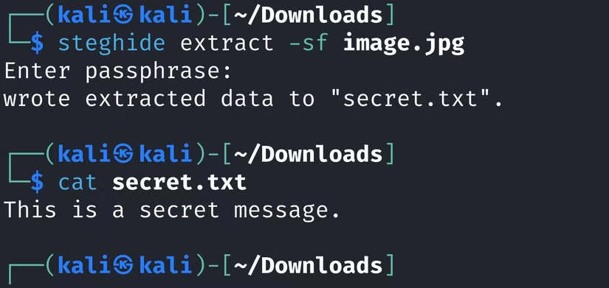
Steghide
“Steghide is a steganography program that is able to hide data in various kinds of image- and audio-files. The color- respectively sample-frequencies are not changed thus making the embedding resistant against first-order statistical tests”
CLI Based application
Stock on kali :)
Allows automated extraction of data from a file (image)
steghide -h to see the tool usage

Slide 23
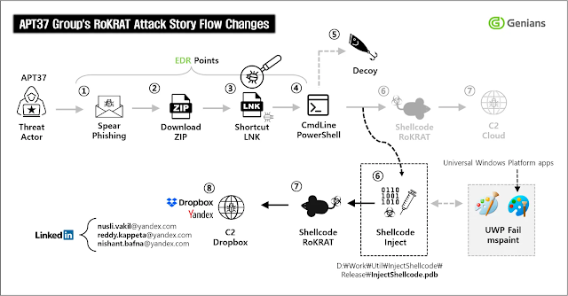

Slide 24
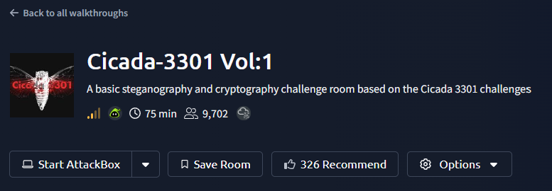
Practical
https://tryhackme.com/room/cicada3301vol1

Slide 25
PUB?

